Slide 1

Graphics and Computational Programming
James Comer

Slide 2
Features
Spheres, planes, cubes, and cylinders
PBR (or Blinn-Phong)
Shadows
Ambient occlusion
Reflectivity
Transparency and refraction
Real time with menus to adjust values
Multi-threaded
Uses thread pooling
Adjust number of tasks a frame is split into independent of the number of threads.

Slide 3
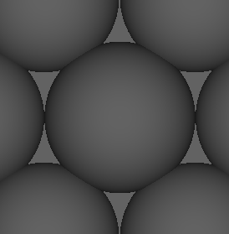
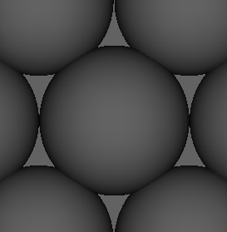
Theory – ambient occlusion
Ambient occlusion is the idea that a point will not receive as much ambient light if there are objects in close proximity to it.
It is used to simulate soft shadows that should occur due to indirect lighting.
Technically ambient occlusion should not occur at points in direct light, but since I don’t have indirect lighting I just apply it everywhere.

Slide 4
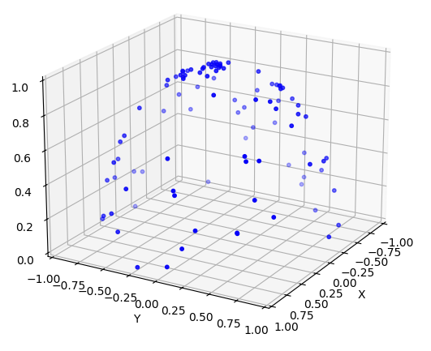
Theory – ambient occlusion
Generate a number of points in a hemisphere and treat these as directions. Invert any that are past 90 degrees from the normal of the point we’re looking at (dot product less than 0).
If a sample hits then we are more occluded and less ambient light should reach this point.
Notes:
(No samples hit all ambient light added, all samples hit no ambient light added, half samples hit half ambient light added)

Slide 5
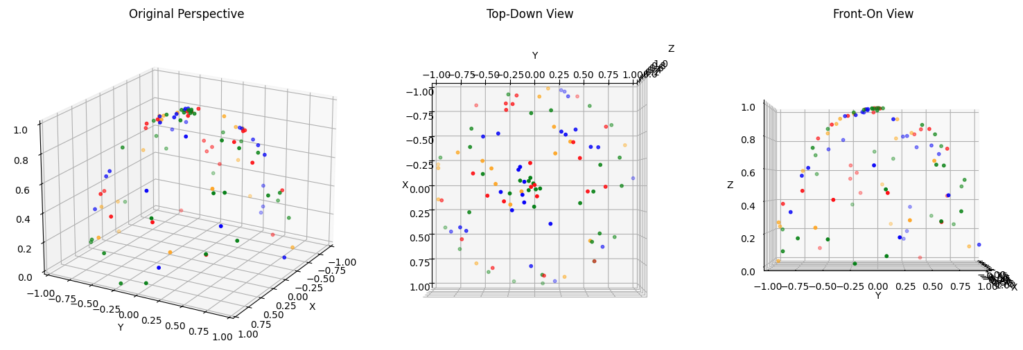
Theory – ambient occlusion
Optimised to split samples into smaller groups and test groups one by one. We exit early when no new samples hit something, assuming no ambient occlusion at this point. Avoids testing lots of samples unnecessarily.
Greatly increases performance in scenes where there isn’t much ambient occlusion.
Sample splitting creates false negative where we exit early assuming no ambient occlusion when, if we tested more samples, we’d find there is some.

Slide 6
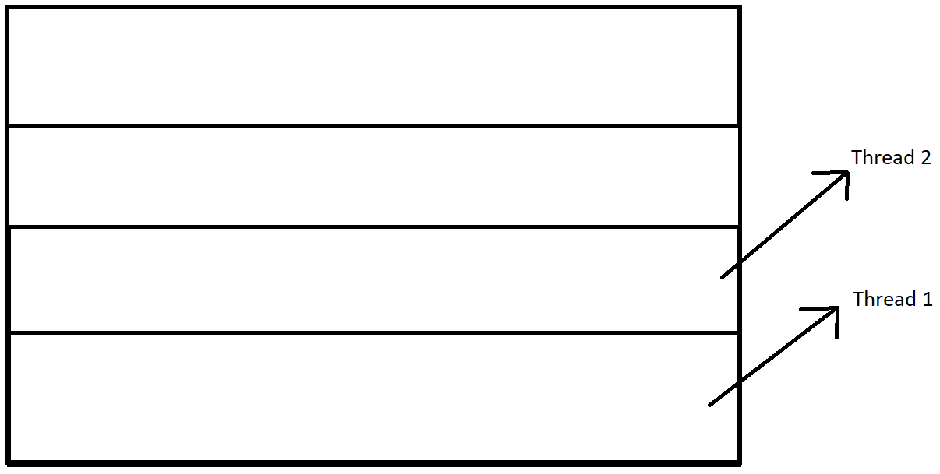
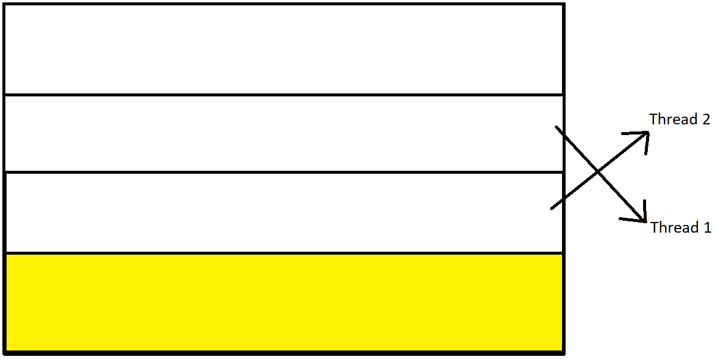
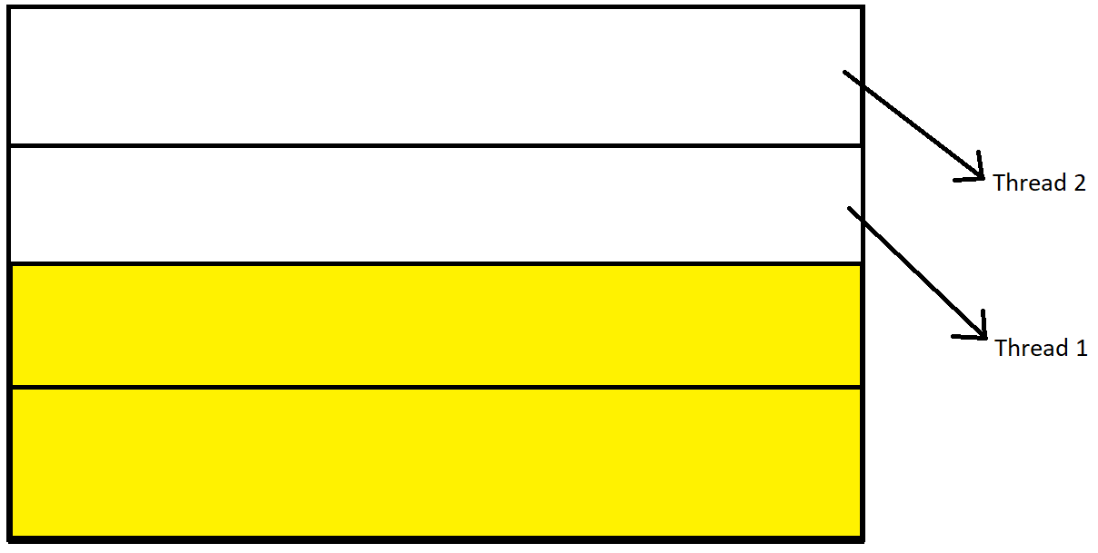
Design
The number of tasks dictates how many separate tasks the screen is split up into.
Those tasks are sent off to the thread pool where one thread will work on one task until it’s done, then that thread will work on the next task that isn’t getting worked on.
Notes:
A lower number of tasks than threads will theoretically simulate that number of threads.

Slide 7
Analysis
All tests use
- 640 x 480 resolution.
- Average frame time over 10 frames.
- Core i7-13700 16 core CPU.

Slide 8
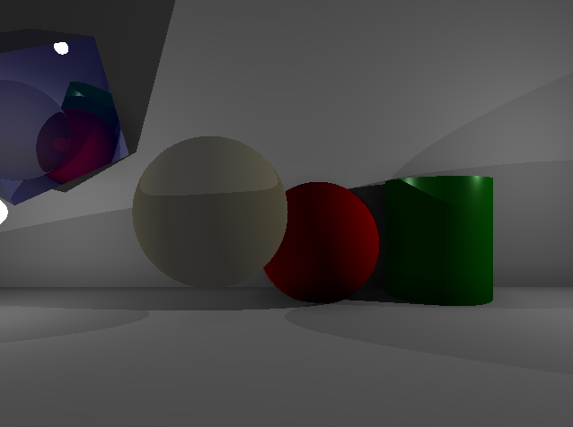
Analysis – test 1, threads
Using scene 1 with 64 ambient occlusion samples with a split of 1.
Tested 1 to 500 frames to see the difference in frame time.

Slide 9
Analysis – test 1, threads

Slide 10
Analysis – test 1, threads

Slide 11
Analysis – test 2, threads & tasks
Using scene 1 with 64 ambient occlusion samples with a split of 1.
Tested continuous number of tasks against set number of threads.

Slide 12
Analysis – test 2, threads & tasks

Slide 13
Analysis – test 2, threads & tasks

Slide 14
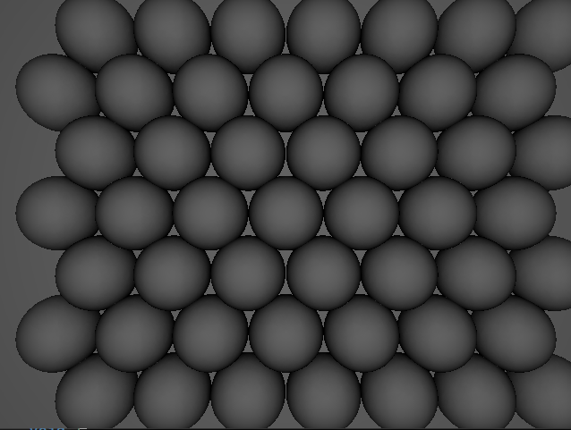
Analysis – test 3, ambient occlusion
Tested different ambient occlusion sample sizes, as well as different number of splits on scene 2 and then scene 1 to see the difference in frame time between differently split samples, and then see how the percentage change differs on a different scene.

Slide 15
Analysis – test 3, ambient occlusion

Slide 16
Analysis – test 3, ambient occlusion

Slide 17
Analysis – test 3, ambient occlusion
Percentage change from splits | 1 to 2 | 1 to 3 | 2 to 3
Scene 1 | 37.62 | 48.75 | 17.84
Scene 2 | 11.70 | 17.89 | 7.01
The optimisation is a lot more effective in a scene with less points that have ambient occlusion.

Slide 18
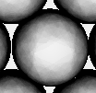
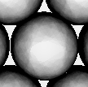
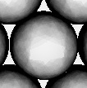
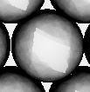
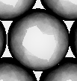
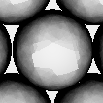
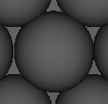
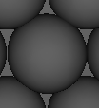
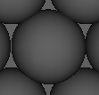
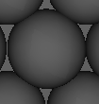
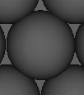
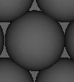
Analysis – test 3, ambient occlusion
1 split
2.5 fps
2 split
2.9 fps
3 split
3.0 fps
4 split
3.2 fps
5 split
3.3 fps
6 split
3.3 fps
Notes:
Ambient light at a much higher value then you would usually have and ambient strength at 2 which means it is 2 times darker than it would normally be. This is to help visualisation.

Slide 19
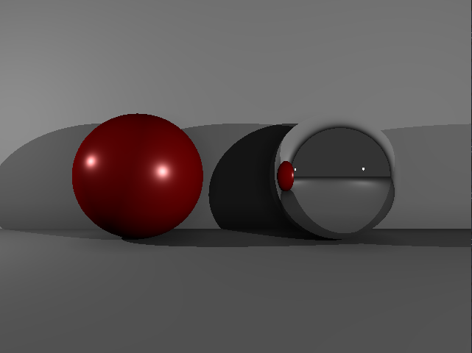
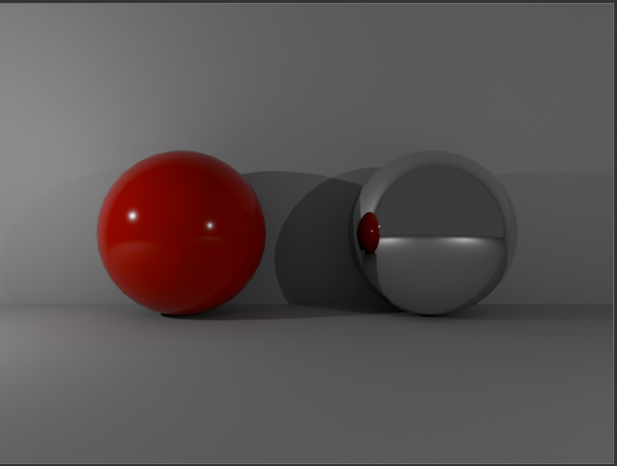
Qualitative

Slide 20
Evaluation
Different ambient occlusion sample sizes, see lower resolution of ambient occlusion.
My scene with scene in blender.

Slide 21
References

